Slide 2
The night has passed and the day lies open before us…
What are you thankful for today?

Slide 3
Let’s do something together… Shall we try something new?
Let’s try some body percussion with “The Beat goes on”.
https://www.youtube.com/watch?v=QOh1P1ZcTaU

Slide 4
We are going to listen to Romantic music
This music was written after Classical Music
1600
1750
1820
1900
2020
Baroque
Classical
Romantic
Modern

Slide 5
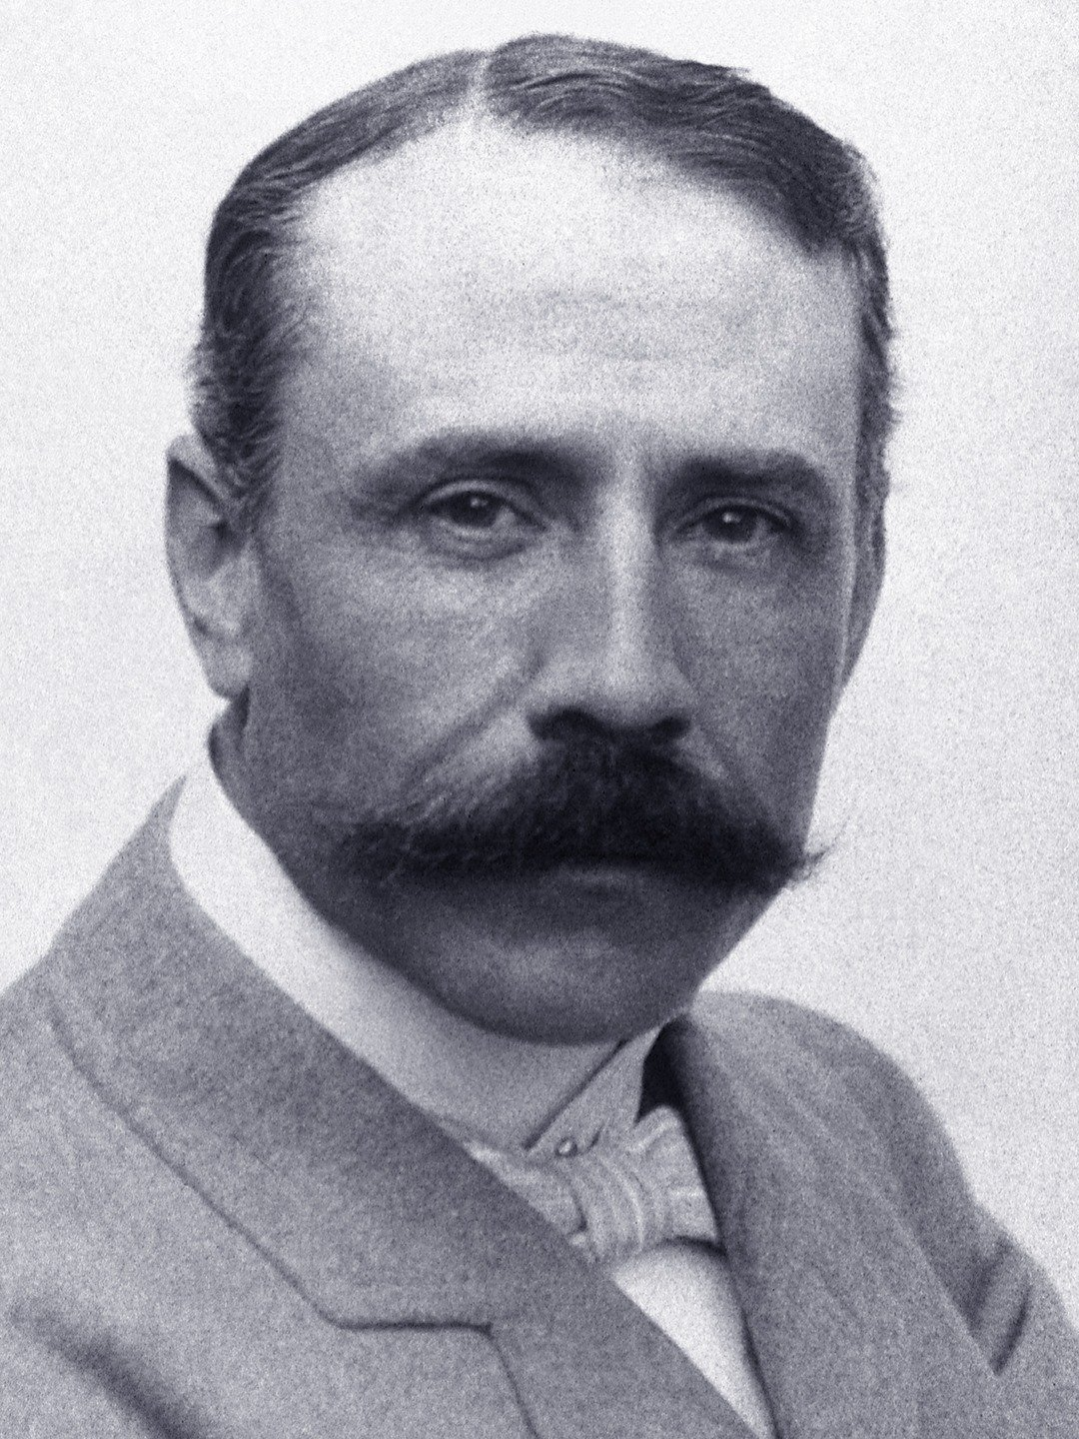
The composer we are going to learn about is Edward Elgar Let’s learn about his pieces called the Enigma Variations.

Slide 7
Watch and learn about how Edward Elgar drew pictures of his friends in music!
https://www.bbc.co.uk/programmes/articles/xFHT9GvfKjBbtw28pgDgyG/enigma-variations-theme-enigma-variations-11-6-7-by-edward-elgar
Notes:
Listening task. Listen to Variation 7 (Troyte) without images. Ask your class to imagine the person being described and jot down their thoughts. You might like to give them the following categories to think about:
Man or woman, boy or girl? Or animal?
Age?
What do they look like?
What are they doing?
Repeat this activity as you listen to Variation 6 (Ysobel) and 11 (G. R. S.)
Discuss their ideas and perhaps create a 'picture' of each person on the board.

Slide 8
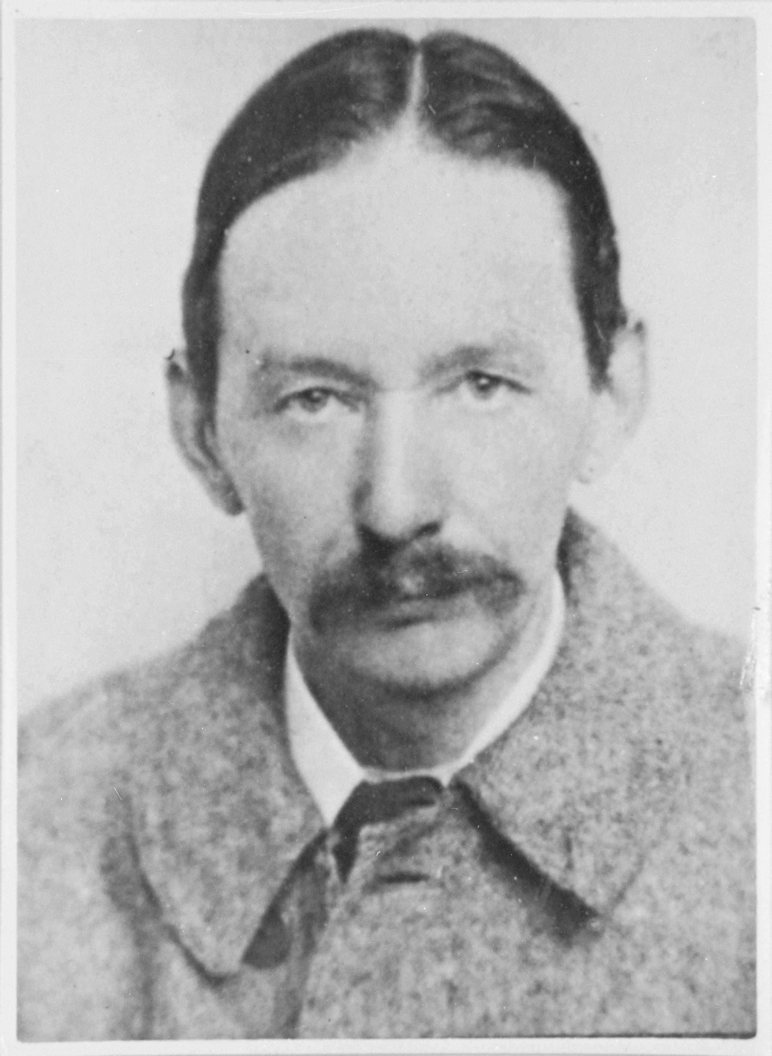
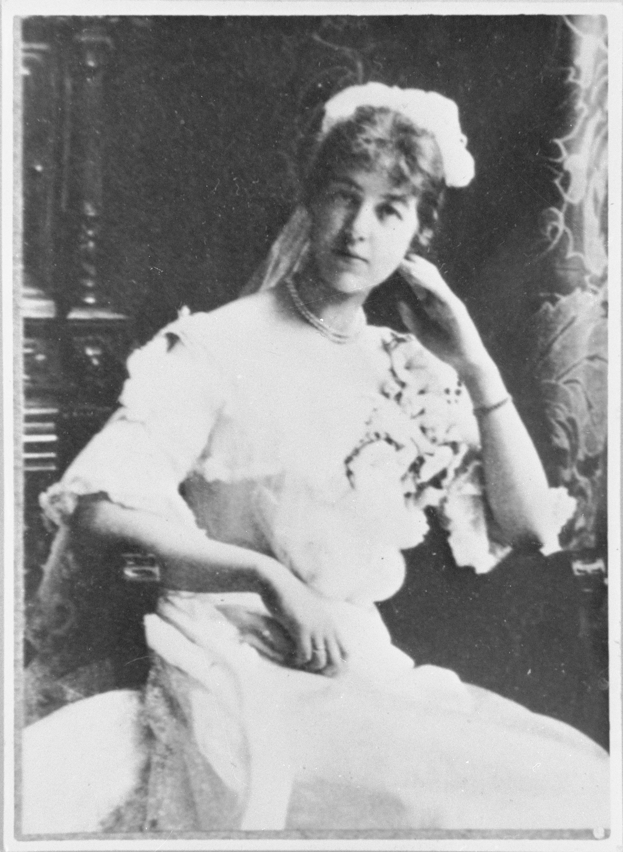
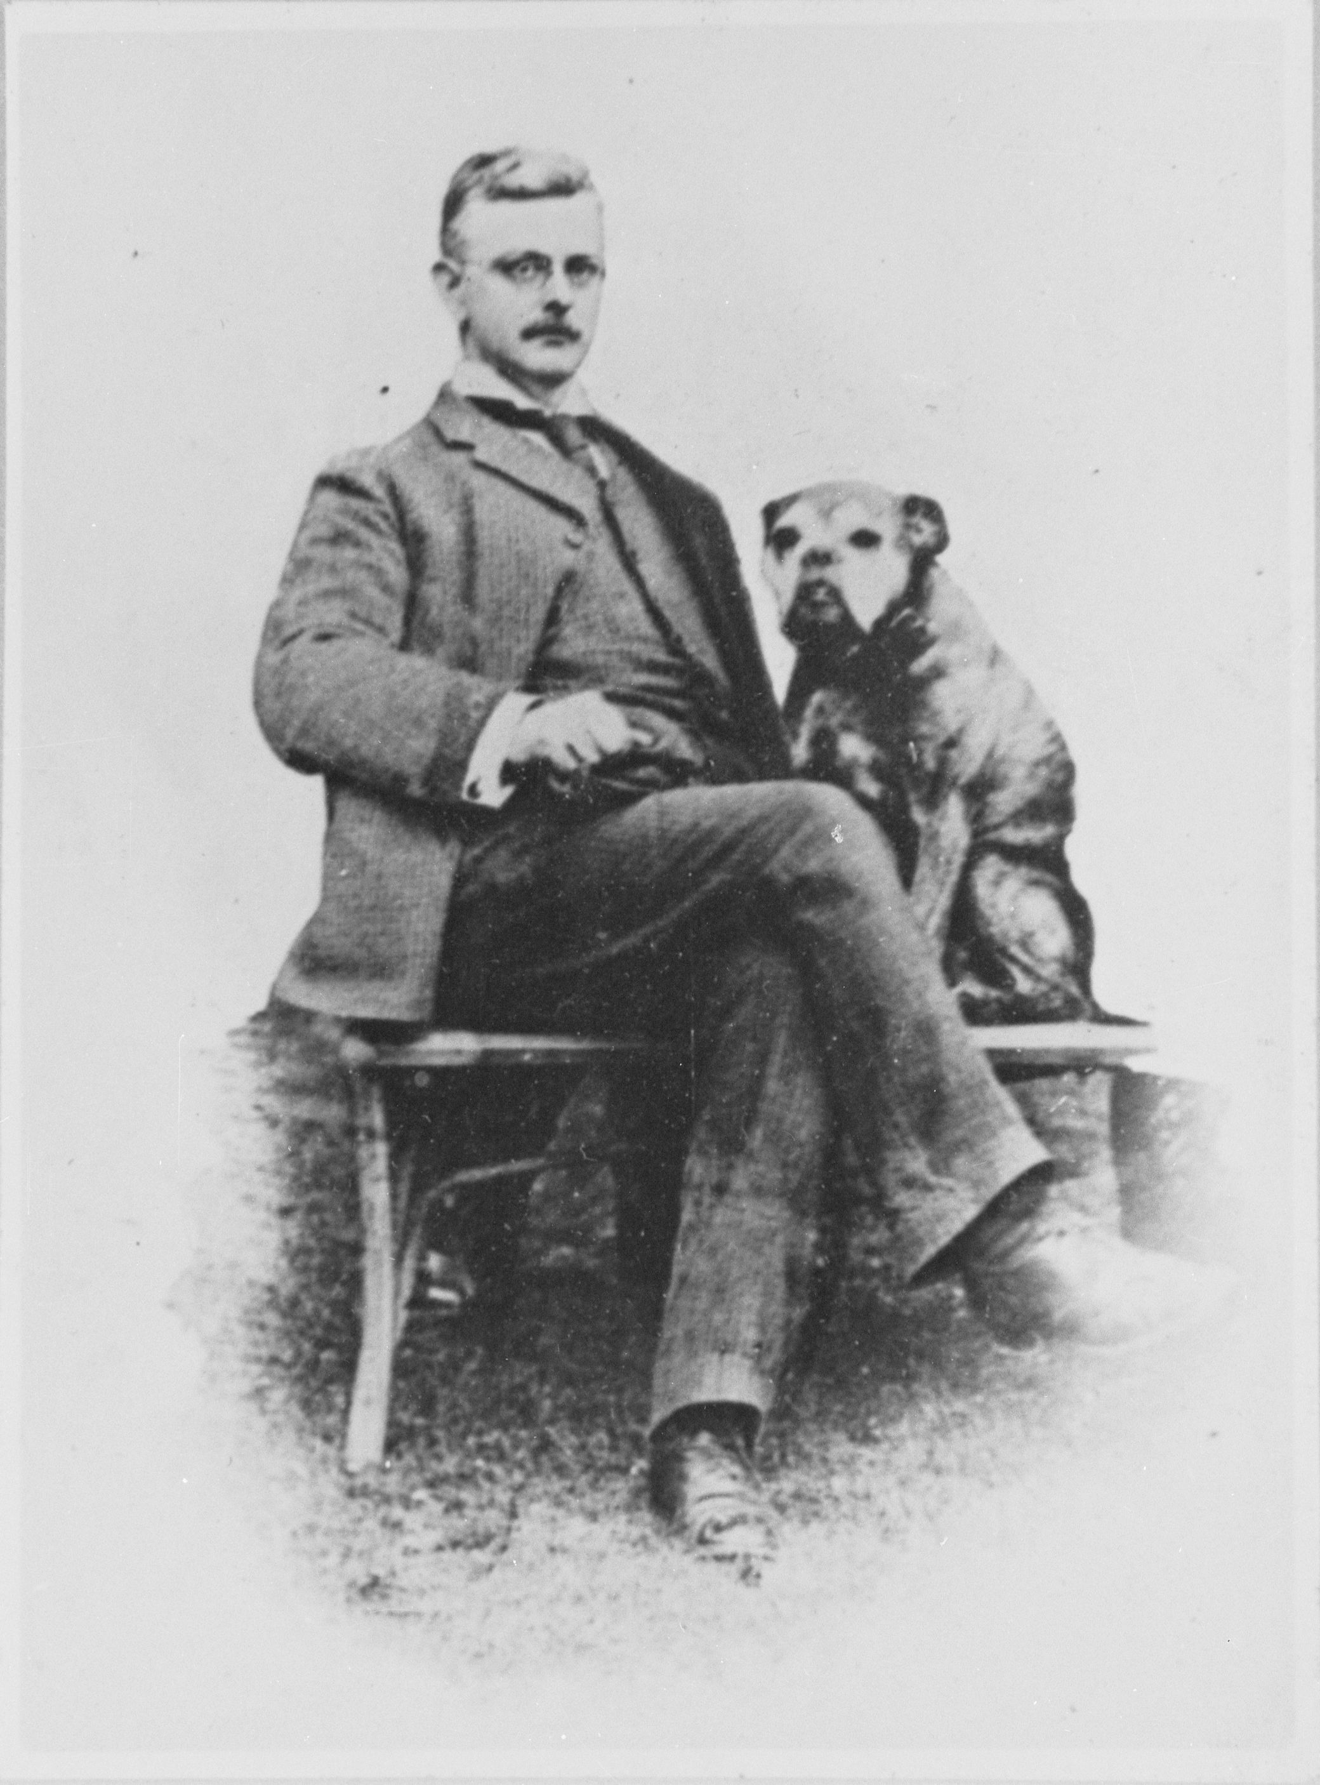
These are the variations:
Variation 7 (Tryote): Arthur Troyte Griffith Male, aged about 40 – one of Elgar’s closest friends This variation depicts him sheltering during a thunderstorm
Variation 6 (Ysobel): Isabel Fitton Female, aged about 30 – she was a beautiful violist This variation depicts her practising her viola
Variation 11 (G. R. S.): A bulldog called Dan Dog! This variation depicts him doing ‘doggy’ things such as running, biting a bone and panting G. R. S are the initials for Dr. George Robert Sinclair who owned Dan the dog
Notes:
Discuss their ideas and perhaps create a 'picture' of each person on the board. Then reveal the real answers:
Now that your children know the answers, play the variations again and challenge them to draw each person (or dog…) as they listen. These are short pieces of music, so urge them to work quickly
Have a look at their pictures and perhaps display them on the wall.

Slide 9
I wonder what sound picture you would make of your friend? Loud or soft? Fast or slow? High or low sounds? Draw a picture of someone in your family or a friend and jot down what music you would create. Some of you might think of an instrument as well.
http://www.bbc.co.uk/programmes/articles/xFHT9GvfKjBbtw28pgDgyG
Notes:
FINALLY - watch the Elgar Ten Pieces film (http://www.bbc.co.uk/programmes/articles/xFHT9GvfKjBbtw28pgDgyG) and afterwards have a class discussion about what you have just seen. You might like to ask the following questions –
Did you like the film?
What was your favourite part?
Who would you make a musical selfie of?

Slide 10
Elgar wrote music for his friends so Let’s pray for friendship
Dear God
Thank you for blessing my life with the gift of friendship.
For those who have chosen to be my friends, I am grateful.
Let our love, respect and affection for each friend flourish.
Make me a good friend, one who is loyal and caring and ready to forgive,
Amen

